Slide 1
Canny Edge Detector
Roshani Narasimhan(2013011104)
Sai Sruthi Talluri(201301143)

Slide 2



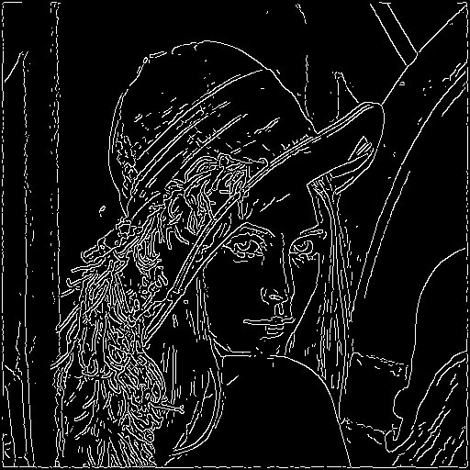
Problem Description:
The canny edge detection is a process which uses multiple steps to detect the edges of an image .The multiple steps are:
Smoothen with Gaussian filter- A gaussian kernel is used to remove high frequency noise from the image. The equation of the kernel is :
where kernel size= 2 * int(2*sigma) + 3. The image is convolved with this kernel matrix. We have chosen sigma as 1.0 thereby getting a kernel of size 7 x 7.
Compute horizontal and vertical gradients- Gradient is the first-order derivative of image in each direction by computing the central difference. deltaX(x,y) = [(x+1, y) - (x-1, y)] / 2 and deltaY(x,y) = [(x, y+1) - (x, y-1)] / 2
Compute magnitude of gradient (Sobel operator)- Magnitude of gradient is computed as follows
Edge points are the points which assume a local maximum in the direct of the gradient.
Perform Non-Maximal Suppression- This is an edge-thinning algorithm. It requires h/v gradients and the magnitude of gradients. One-pixel wide edges are generated as a result of this process, by comparison of the values of the neighbouring pixels. If the value of the current pixel is not greater than the neighbouring pixels in all the eight directions, then it does not belong to an edge.
Perform Hysteresis Threshold- This process removes weak edges and connects the splitted edges. If a pixel value is greater than a high threshold value and all its neighbours are greater than a low threshold value then the pixel belongs to an edge.
The problem thus mainly consists of the following parts:
Loading of the image
Construction of a kernel and convolution with the image. (Gaussian filter)
Computation of gradient and its magnitude.(Sobel operator)
Edge-thinning
Removal of weak edges and edge tracking by hysteresis.
Creating an image of the strong edges.

Slide 3
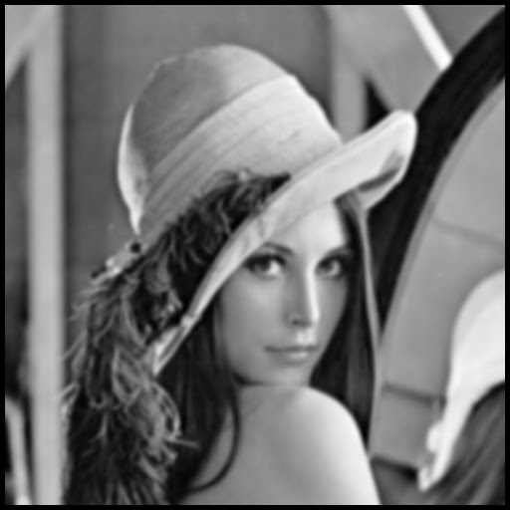
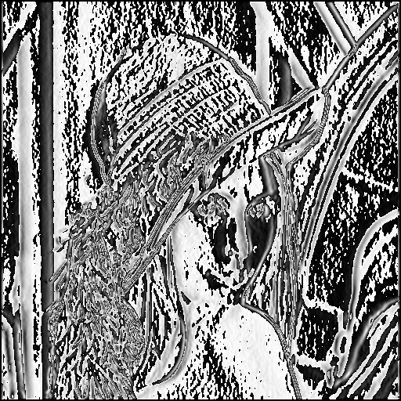
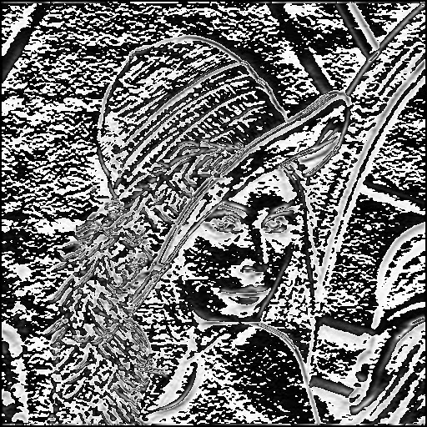
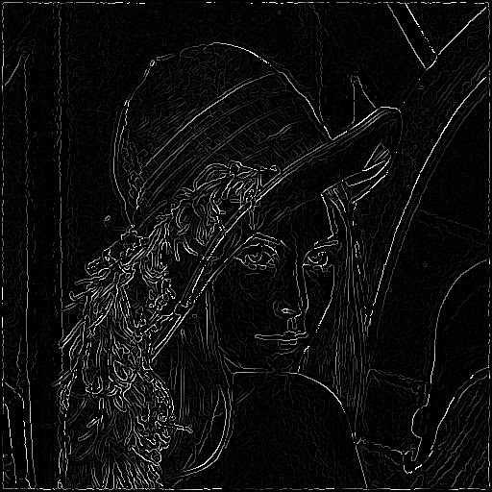

Slide 4
Scope of Parallelization
1. Reading / Writing into the bmp file is a serial process.
2. Construction of Kernel is a serial process since there are data dependencies. However the convolution process is highly parallelizable. Each of the threads gets a few rows of pixels to convolve with the kernel. There are no data dependencies in convolution. Thus smoothening consists of a serial and a parallel portions.
3. Computation of gradient is a fairly parallelizable process since the calculation of gradient for each pixel is independent of the calculation of values of other pixels. Thus each thread gets a set of rows of pixels for which it has to compute the gradient by considering 3 pixels at a time. The computation of magnitude is similarly parallelizable.
4. Non-maximal suppression process is parallelizable since it considers eight of the neighbouring pixels at a time and find out whether the given pixel is maximum within its neighbours. If the given pixel is maximum among its neighbours, it is included in the edge set else it is set to the colour black. The inclusion and exclusion of each pixel is independent of that of other pixels. Again, each thread gets a set of rows of pixels to work upon.
5. The edge-tracking process by hysteresis simply compares the value of each pixel with a threshold maximum brightness and a threshold minimum brightness and decides whether a pixel has to be included or not. Since this task is fairly straight-forward, creation of threads merely increases the overhead. Hence we have kept this portion serial.

Slide 5
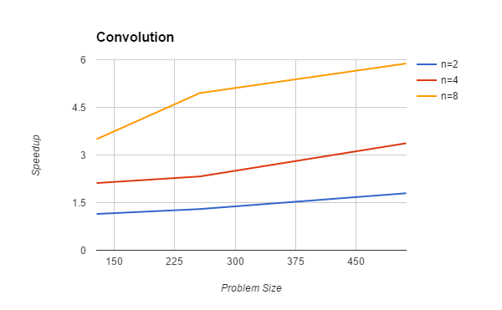
Convolution:

Slide 6
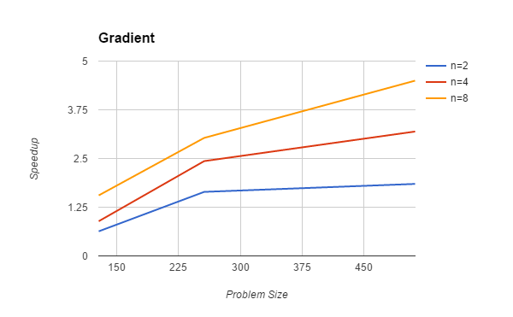
Calculation of Gradient:

Slide 7
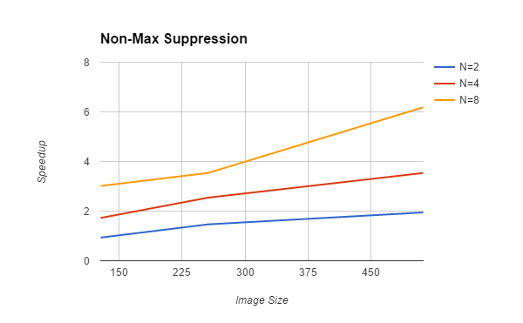
Non-Maximal Suppression:

Slide 8
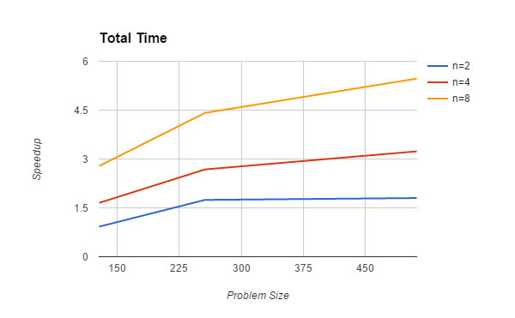
Total Speedup:

Slide 9
Scheduling:
The basic idea of scheduling is to keep the cores busy as much as possible by giving almost equal work to all the cores as this would maximize parallelism and improve the efficiency.
The time taken for each procedure shows that guided scheduling works better than static and dynamic scheduling. This is because of the fact that the guided scheduling is characterized by the fewest number of synchronizations and the work-load is most efficiently balanced among the cores , starting with bigger chunk size and gradually decreasing it. We observed that dynamic takes more time because each thread has to take chunk-size amount of iterations from the work queue . Thus there is a lot of overhead due to context switching, locking of the resources and synchronization. Static scheduling is the better than dynamic to avoid memory conflicts since better cache efficiency is ensured although it has poor load balancing, also most of the dividing work is done during compile time itself.
The values for time taken in Non-Maximal Suppression for image of size 512x512 and a chunk size of 8 :
Schedule | n=2 | n=4 | n=8
Static | 0.016776 | 0.009229 | 0.005279
Dynamic | 0.017663 | 0.009657 | 0.005527
Guided | 0.016925 | 0.009200 | 0.005260

Slide 10
Karp Flatt Metric:
The Karp Flatt Metric is the measure of fraction of experimentally determined serial portion in parallelized code.
The value of the e almost remains constant. The slight increase in the beginning states that the parallel overhead is of considerable magnitude as compared to the serial and parallel time. However, it becomes constant later, stating that the poor speedup is due to inherently serial code.
The formula used for calculation of e, where p is the number of threads and ψ is the speedup obtained.
e=(1/ψ-1/p)/1-1/p
Here we have calculated the value of the serial fraction in the Non-Maximal Suppression for fixed problem size and different number of threads.
n=2 n=4 n=8
Value of e 0.02794117634 0.04366830068 0.0419817927

Slide 11
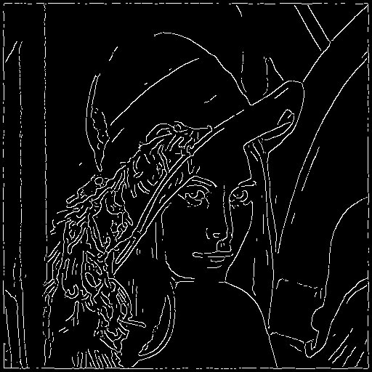
Conclusions
The scope of parallelization increases with the increase in problem size as there is more work that could be done concurrently by the threads, hence for a fixed number of cores, the speedup increases with increase in problem size.
An optimal chunk size must be chosen for scheduling in order to avoid large overheads due to context switching and synchronization among threads. We have used 8 as the chunk size.
Increasing the value of sigma increases the kernel size thereby creating a very smooth version of the original image causing loss of edges during gradient computation. Thus an optimal value of sigma must be chosen.

